Slide 1
OLEI Survey
ELRC Final Presentation
Manoj Gurram
Kunal SomendraSingh Chi-Chuan Hsu
Manoj Kumar Reddy Peta
Sai Aakarsh Padma
Sai Nitin
Vinayaka Madhukeshwar Hegde

Slide 2
Introduction
This project is in continuation of previous project to bring the Synergistic Leadership Theory, a modern take on leadership theory, into a practical and interactive web application.
The goal of this project is to enhance the functionality and allows users to assess leadership effectiveness through the Organization and Leadership Effectiveness Inventory (OLEI).
This project focuses on enhancing existing OLEI survey and provide additional features for enhanced robustness of the survey.

Slide 3
Introduction
Stakeholders include Dr. Beverly Irby and Minoo Mohammadi, alongside a team of students committed to transcending traditional, male-dominant leadership paradigms.
The platform features an animated, interactive tetrahedral model representing the theory's core factors:
Leadership Behaviors
Organizational Structure
External Forces
Attitudes, Values, and Beliefs.
This tool will facilitate the admins to have access to all surveys taken and modify admin roles for the project as per requirement.

Slide 4
OLEI Survey
Primary Modifications:
Store OLEI survey responses in a dedicated Admin Dashboard to view all survey taken.
Analyse supervisor vs. supervisee survey responses to find misalignment and similarity in survey.
Represent the differences in form of a tetrahedron shape for supervisor and supervisee response.
Download the individual survey response for better analysis.

Slide 5
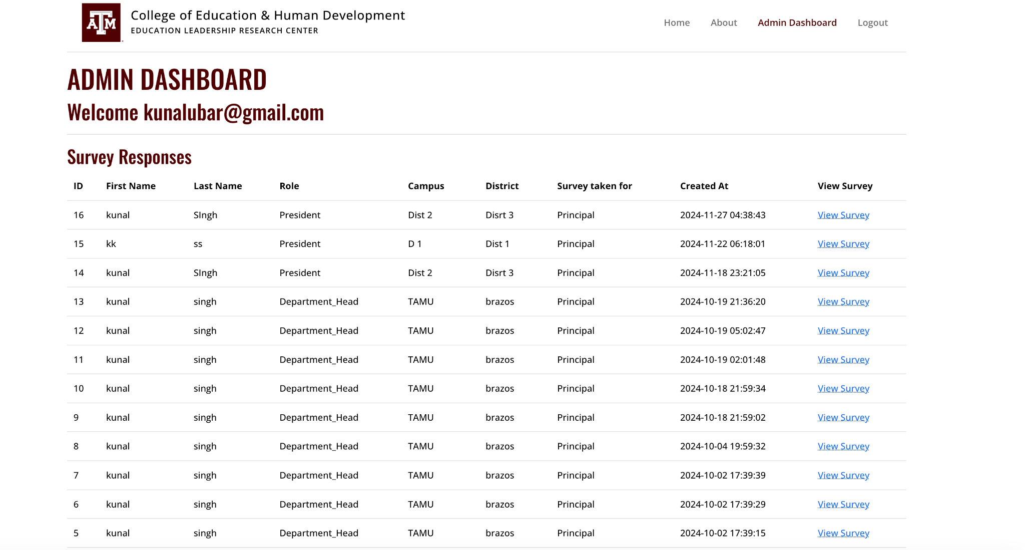
OLEI Survey - Admin Dashboard
The Primary goal of this project was to deliver an Admin Dashboard to the client that will store all the surveys taken by different schools and roles.
The Admin Dashboard will only be accessible to admins for better analysis of the survey responses.
The analysis is further improved through individual response report download feature to focus on individual response.
Utilised Google Auth0 login portal to help assign user roles to various participants of the survey.

Slide 6
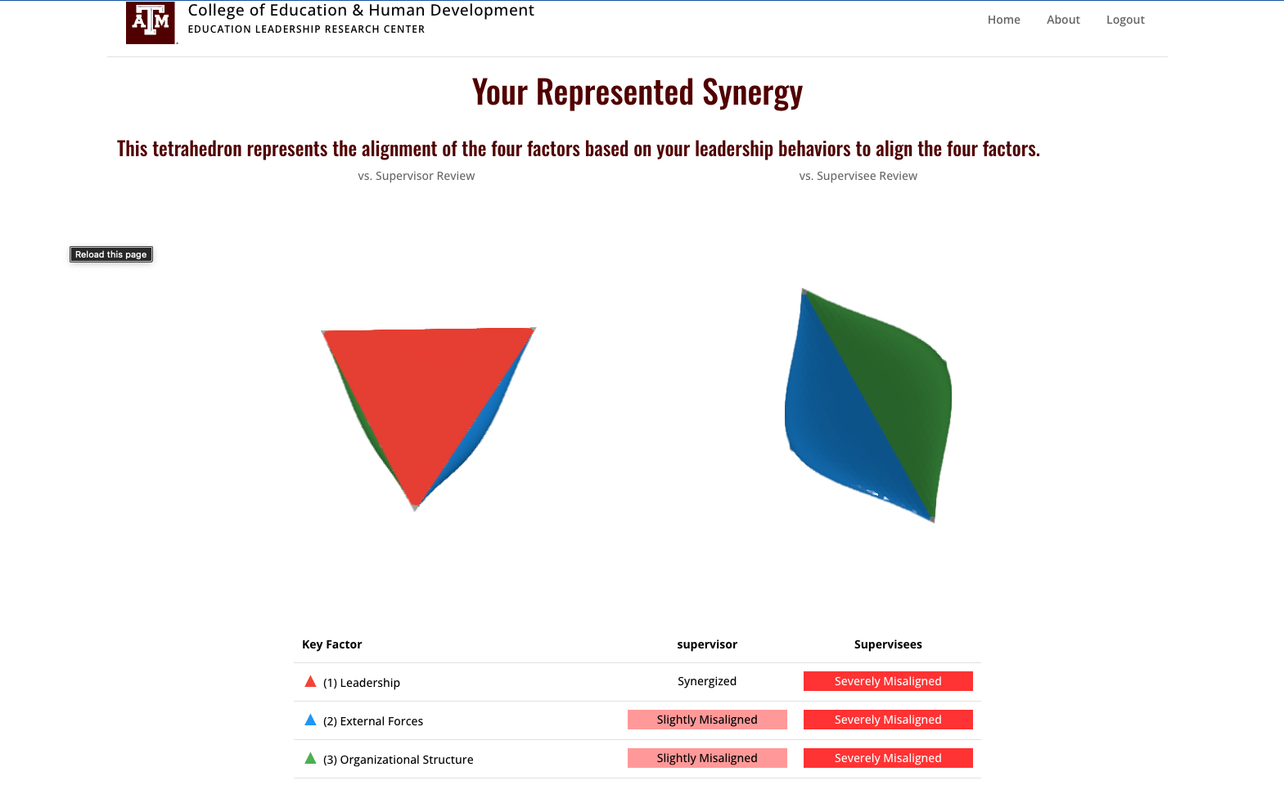
OLEI Survey - Analysis
Main function of application is the analysis of leadership style synergies.
This was achieved by plotting the survey responses and their differences through a tetrahedron model.
A higher bulge in the tetrahedron indicates misalignment in the survey response and a flat surface indicates synergised responses.
When the different levels of leadership fill out the survey on a specific individual, the individual’s style will be compared to the rest for synergy and alignment.

Slide 7
OLEI Survey - The Interactive Model
The OLEI uses a bulging tetrahedron to intuitively visualize the alignment between a leader and their organization.
The tetrahedron model is an effective
way to display the differences between
responses in a intuitive manner.

Slide 8
Design - Methodology
Agile Development Lifecycle:
We structured our work into four distinct sprints, each culminating in a unique minimum viable product (MVP) and concluding with a phase dedicated to documentation and reflection.
We maintained regular communication through bi-weekly Scrum meetings with the development team and weekly meetings with the client, ensuring all stakeholders remained informed about ongoing tasks, expectations, and product progress.

Slide 9
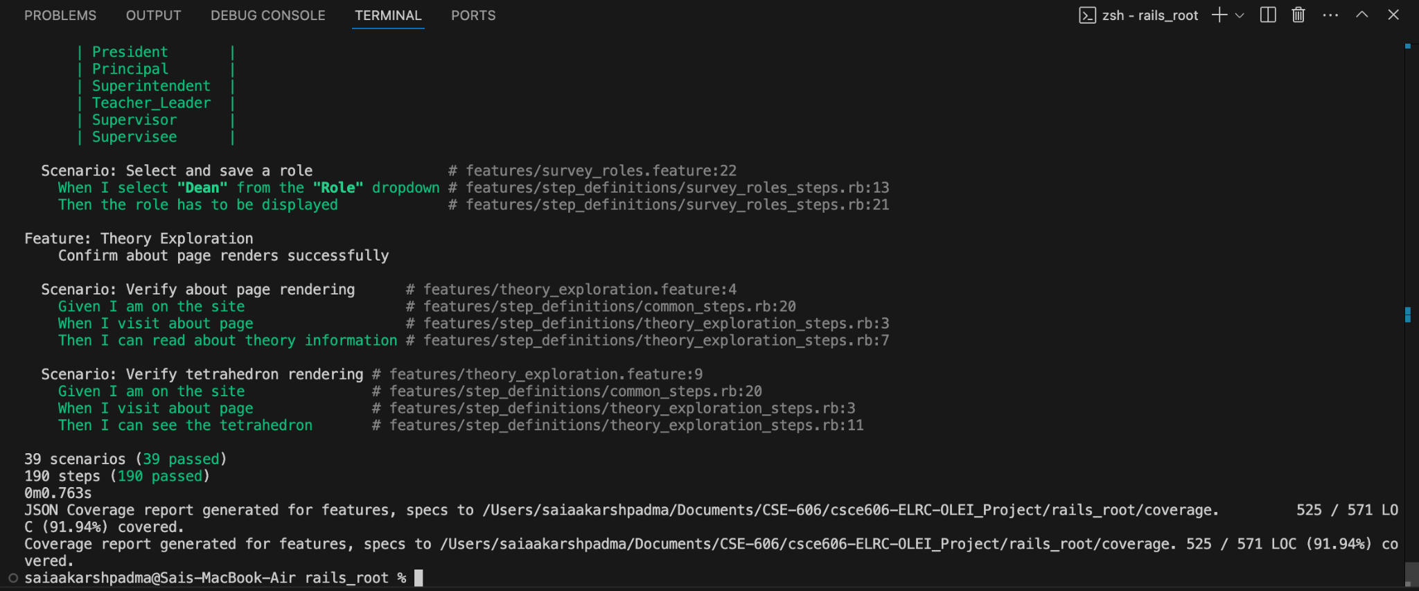
Design - Development Practices
Test and Behavior Driven Development (TDD / BDD):
We adopted a test-driven development approach, creating feature tests prior to implementing the features themselves in each sprint.
This strategy provided us with clear, functional criteria for each feature before investing time in actual implementation, significantly streamlining our development process.
As a result, we experienced a substantial reduction in debugging time per sprint and built a comprehensive test suite for all existing features, enhancing the overall quality and reliability of our product.

Slide 10
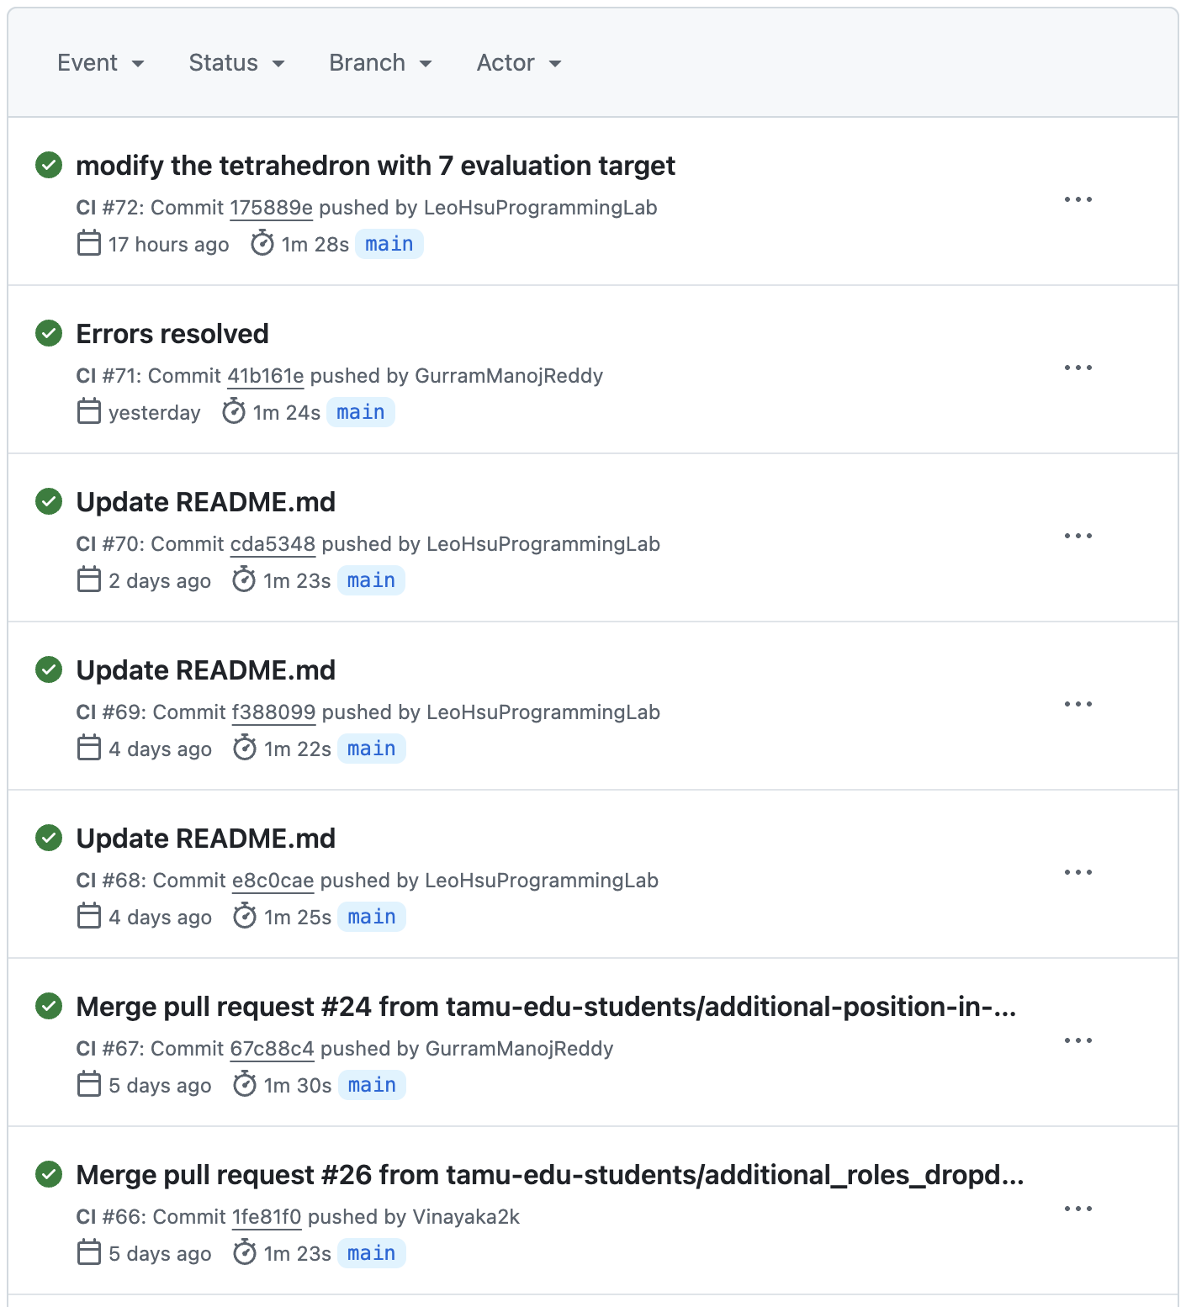
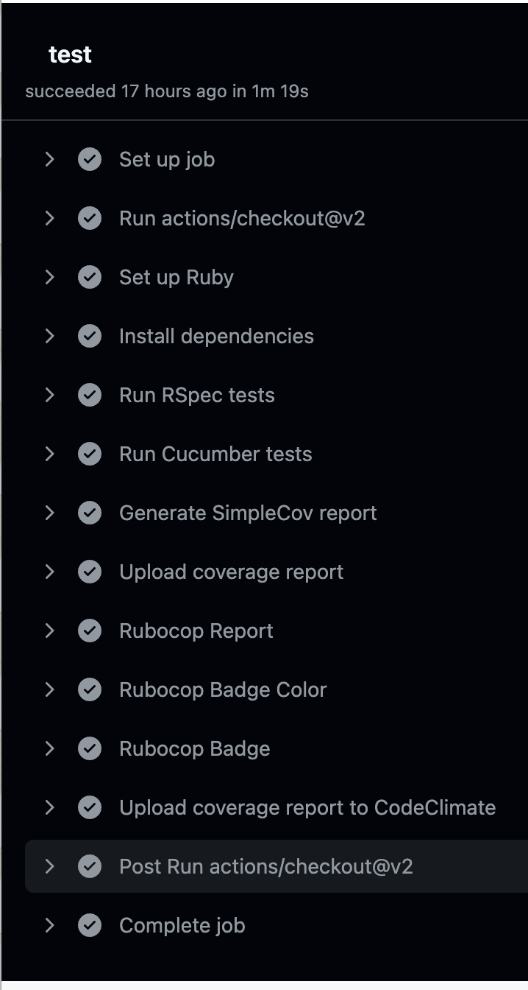
Design - Development Practices
Continuous Integration / Continuous Deployment (CI/CD):
GitHub Actions runs RSpec and Cucumber tests on code ready to be deployed.
To merge the branch to main these tests need to be passed.

Slide 11
Challenges
Translation of Theory to Application:
Generating the tetrahedron based on survey results and determining the factors that influence its shape was a challenging aspect of our project, but with the client's thorough explanation of the theory, we were able to effectively incorporate these elements as the project progressed.
New Frameworks:
Navigating the legacy codebase presented an initial challenge for our team, as we were all newcomers to Ruby, requiring a concerted effort to comprehend the code structure and flow.

Slide 12
Lessons Learned
Gaining clear understanding of client expectations:
To navigate the challenges of working with legacy code and optimize our limited project timeframe, we prioritized clear communication with the client and adopted effective development practices, enabling us to understand the intricacies of the existing codebase, implement agile methodologies, and consistently deliver value aligned with the client's evolving requirements.
Importance of writing testable, reusable code:
To ensure our application consistently met all primary use cases and diverse user stories, we maintained a minimum viable product for each scenario through regular smoke tests and test-driven development, guaranteeing that all application dependencies and use case paths remained functional and available to the sponsor.

Slide 13
Thank You

